Slide 1


Slide 2
Student Performance Analysis with Machine Learning
Submited By ,
Samadhan Kale
[7236-2022 DA Batch Pune-EXL]
(EBEON0322574657)
Guidance:- Karthick sir

Slide 3
Objectives
To check the Effect of Lunch on Student’s Performance.
To check the effect of test preparation course on scores
To know which factor may affect the student's performance, we classify the score into couple of ranks, and figure out which feature affects the score more significant.

Slide 4
ML-Algorithms used
Logistic Regression
K-Means
SVM rbf
Random Forest
Decision Tree
KNN-[K- Nearest Neighbours]

Slide 5
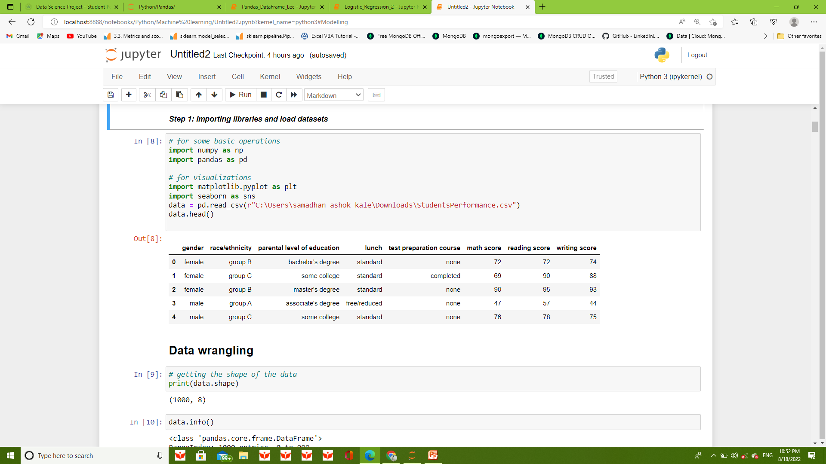
Data Collection

Slide 6
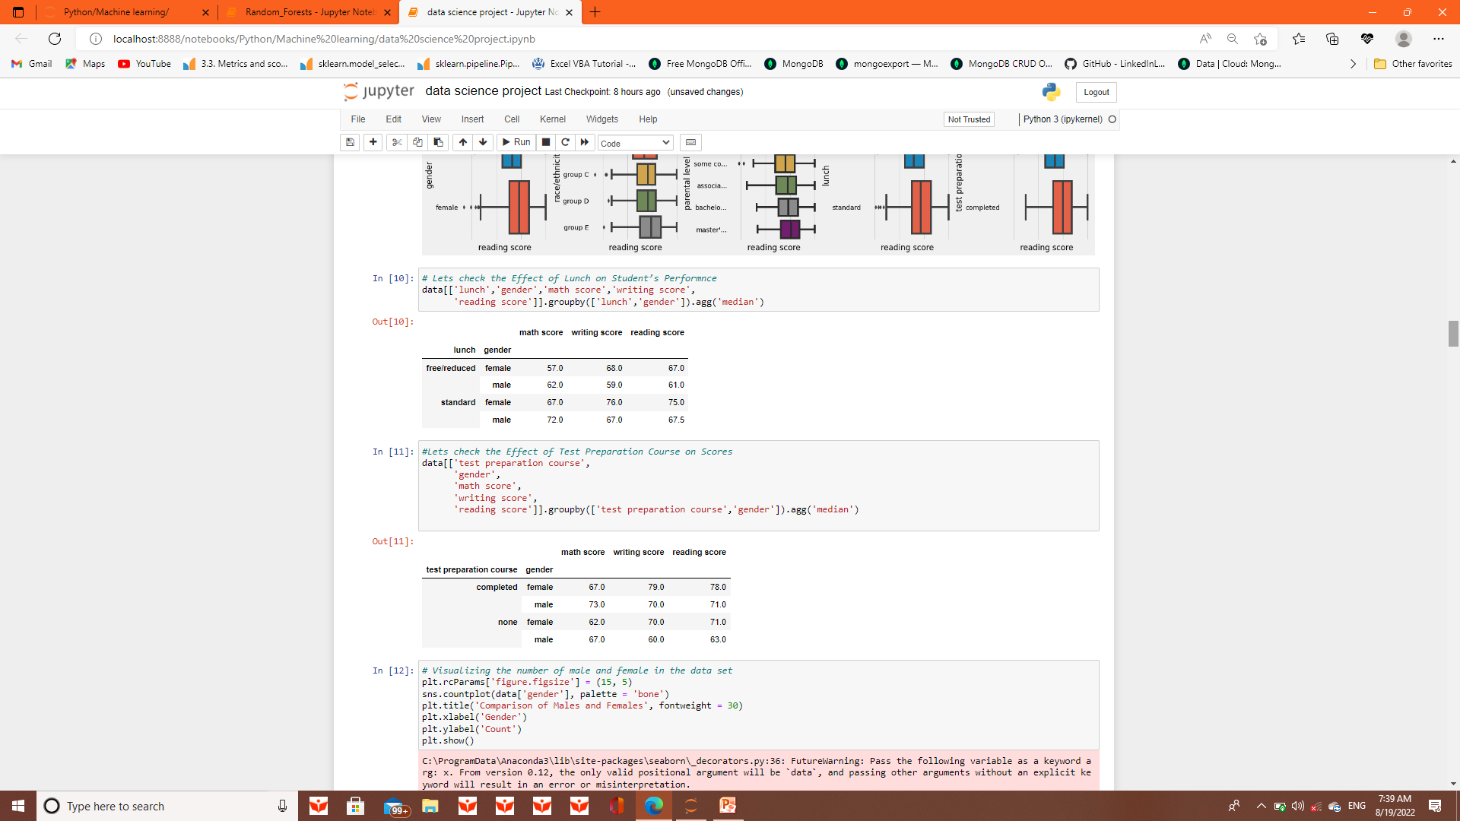

Slide 7
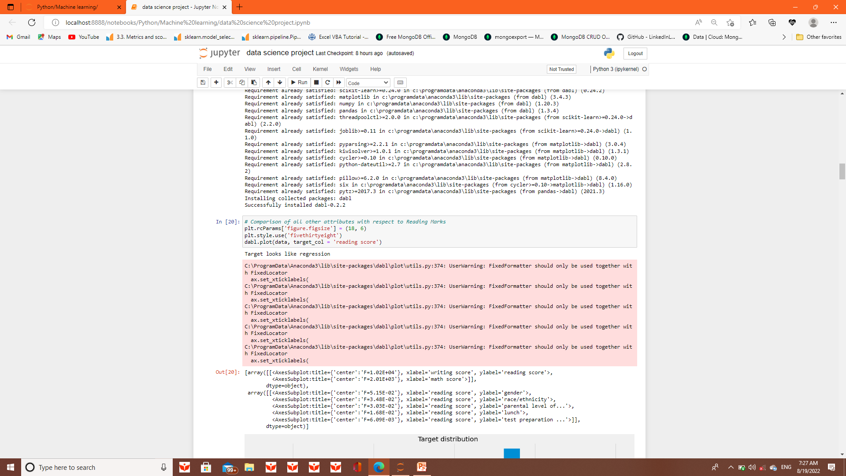
Data Visualization

Slide 8
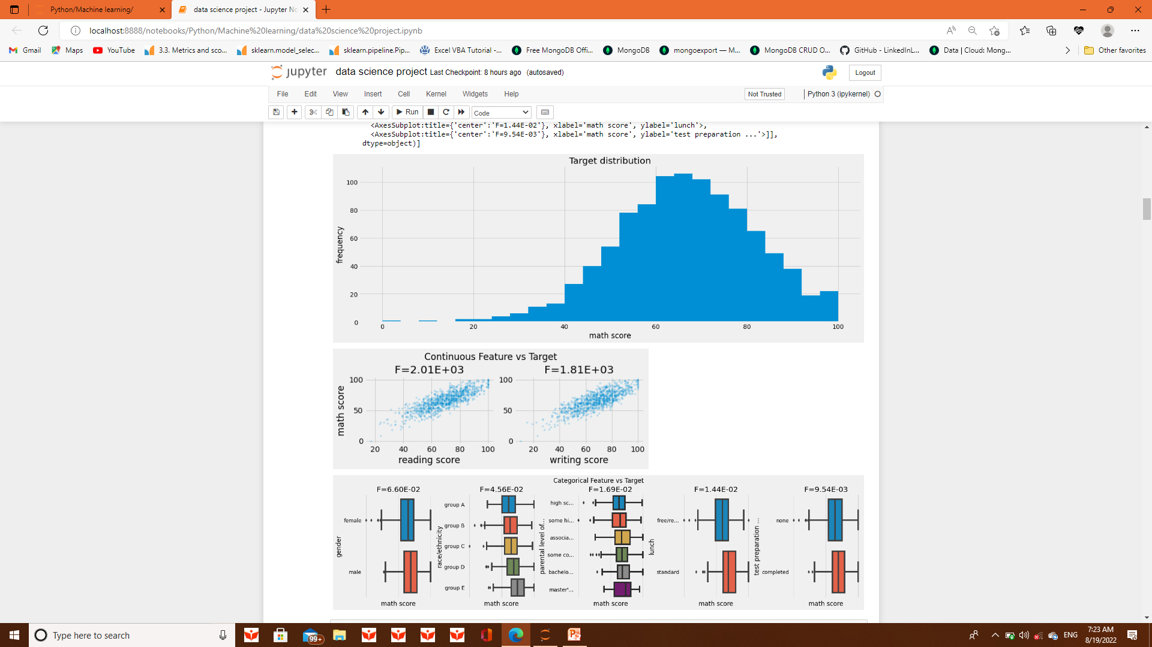

Slide 9
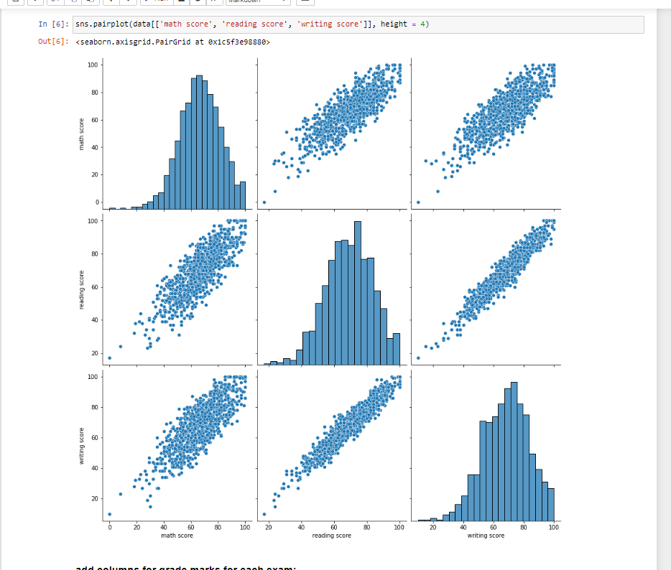

Slide 10
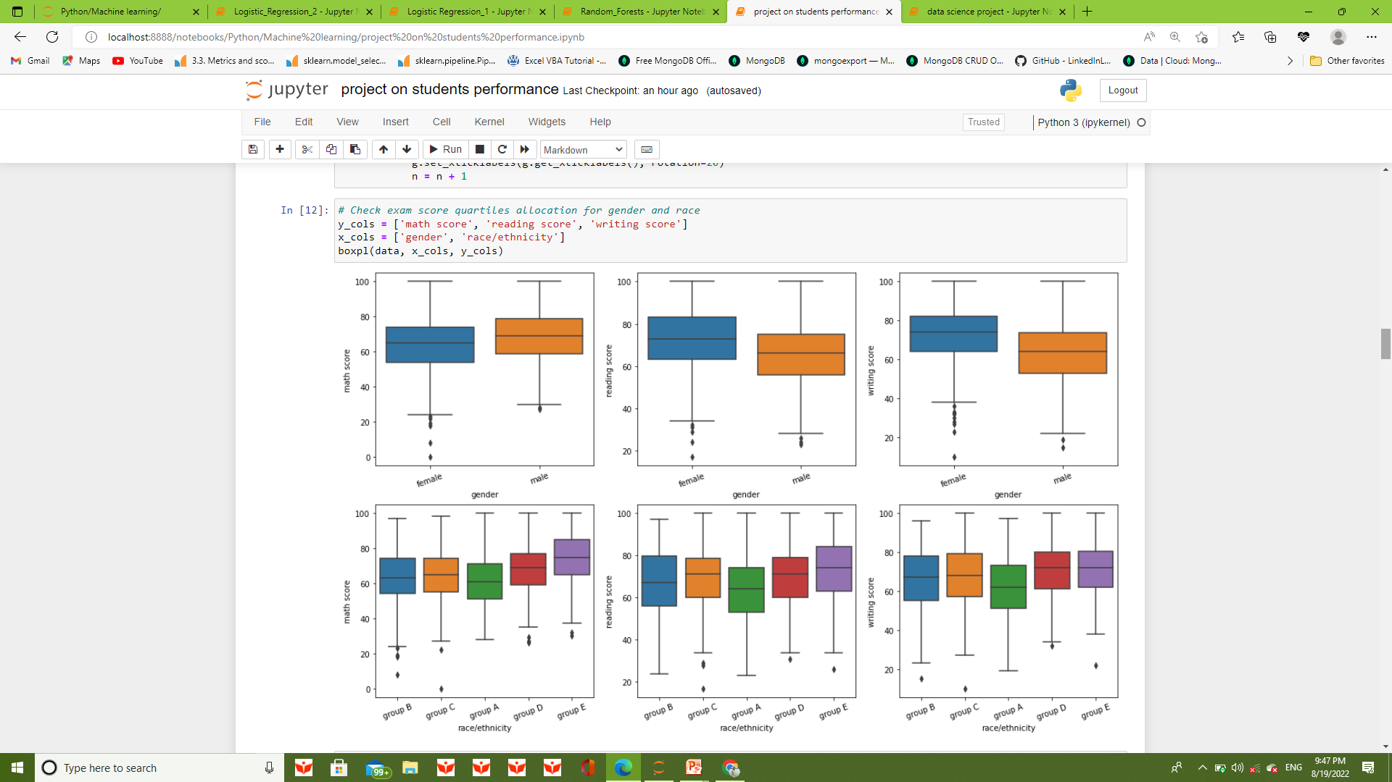

Slide 11
Exploratory data analysis
Exploratory Data Analysis refers to the critical process of performing initial investigations on data so as
to discover patterns,
to spot anomalies,
to test hypothesis and
to check assumptions with the help of summary statistics and graphical representations.

Slide 12
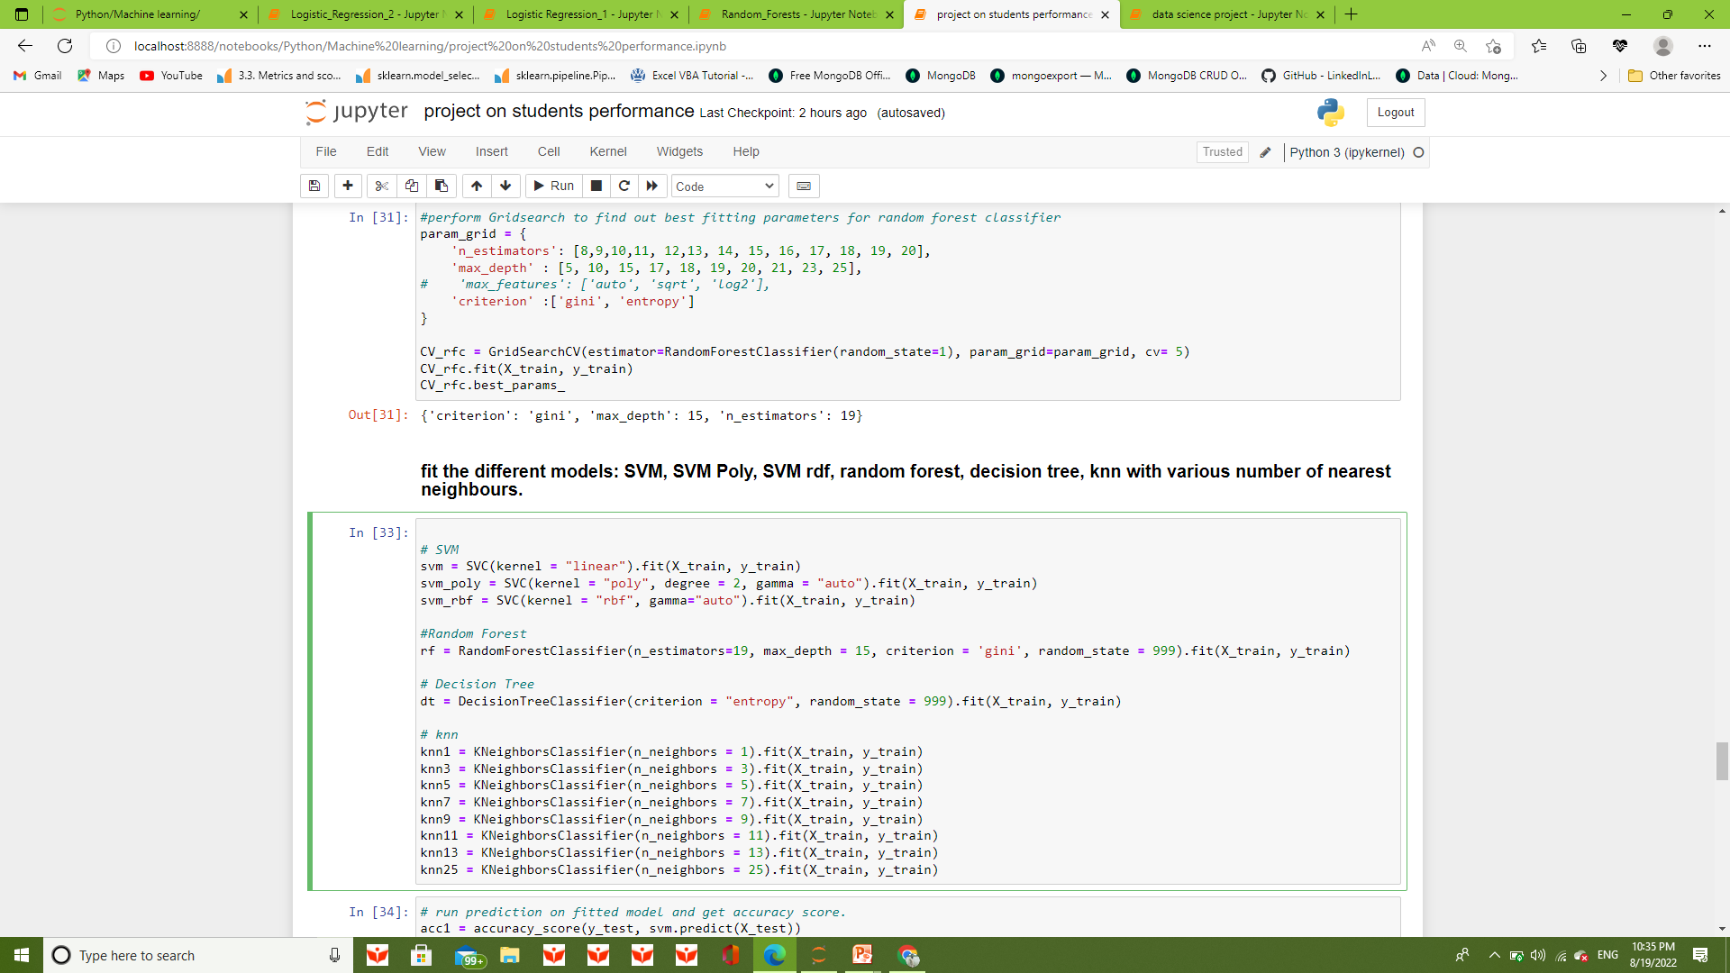

Slide 13
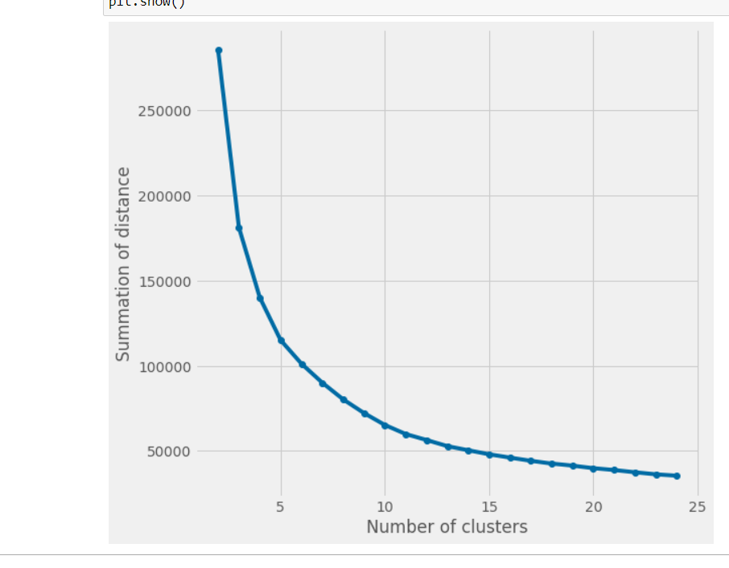
PCA - ANALYSIS

Slide 14
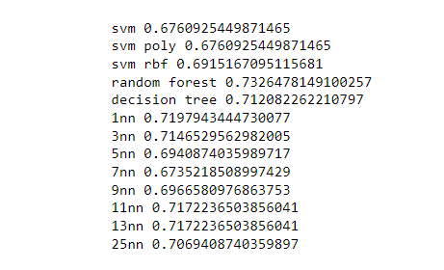
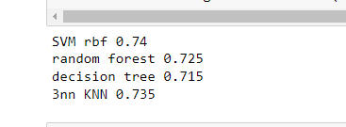
Model predictions

Slide 15
Conclusion
There are few conclusions below:
Parents' education level may affect the performance of students, but not the important one.
Finishing preparation course is benefitial.
Having lunch is important to students, and it is also the most significant one.
Gender has no correlation with the score.​In summary, if students want to have good performance, they should have enough nutrient and make effort to prepare the test.

Slide 16
Any questions

Slide 17


